Slide 1

SMEAL COLLEGE OF BUSINESS BUILDING
University Park, PA
Yena K. Han
The Pennsylvania State University
Architectural Engineering, Lighting/Electrical
Faculty Advisor: Richard G. Mistrick, PhD, PE, FIES
Electrical Advisor: Theodore H. Dannerth, PE

Slide 2
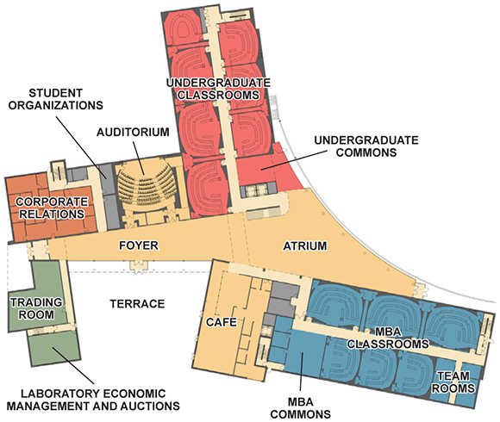

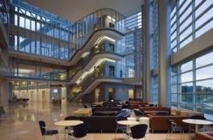
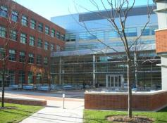
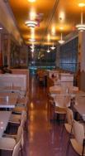
BUILDING BACKGROUND
ARCHITECTURE BREADTH
  South Terrace Redesign
LIGHTING DEPTH
  South Terrace
  Typical Large Classroom
  Three Alternate Designs
  Atrium
  Blue Chip Bistro Café
ELECTRICAL DEPTH
  Copper vs. Aluminum Feeder Comparison
  Distribution Panel Redesign
  Lighting Branch Circuit Redesign
  Short Circuit Study
ACOUSTICS BREADTH
  Café Ceiling Design Study
CLASSROOM
ATRIUM
TERRACE
CAFE
OVERVIEW

Slide 3
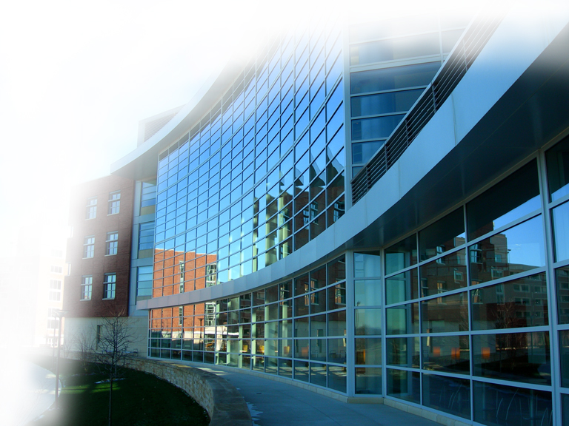
ARCHITECTS
ASSOCIATE ARCHITECTS
MEP ENGINEERS
CONSTRUCTION MANAGER
PROJECT COST
SCOPE
LEVELS
CONSTRUCTION SCHEDULE
DEDICATION DATE
Bower Lewis Thrower Architects (Philadelphia, PA)
Robert A. M. Stern Architects (New York, NY)
Bard, Rao + Athanas Consulting Engineers (Boston, MA)
Gilbane (State College, PA)
$68,000,000
210,000 SF
Four above grade, one below grade
July 2003 – July 2005
September 30, 2005
BUILDINGBACKGROUND

Slide 4
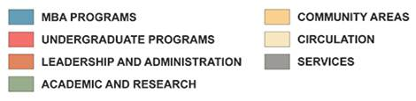
ARCHITECTURE BREADTH
TERRACE REDESIGN
ARCHITECTUREBREADTH

Slide 5
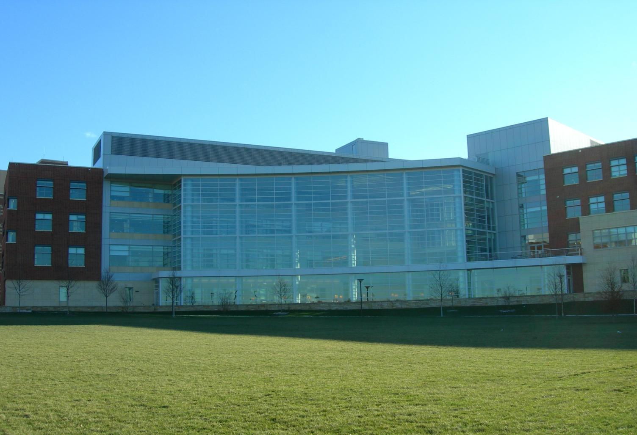
ARCHITECTUREBREADTH

Slide 6
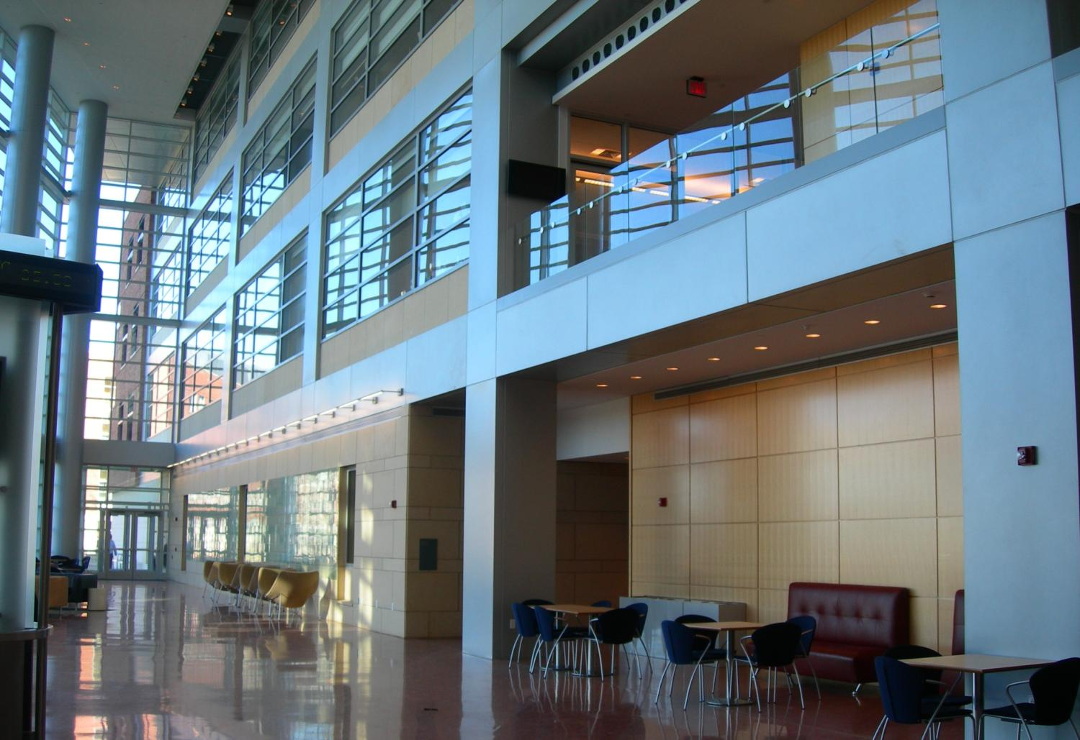
ARCHITECTUREBREADTH

Slide 7

EDUCATIONAL FACILITY
Business School
The “Real [Professional] World”
THE SMEAL COLLEGE VALUES
Openness
Transparency
Community
ARCHITECTUREBREADTH

Slide 8
ARCHITECTUREBREADTH

Slide 9
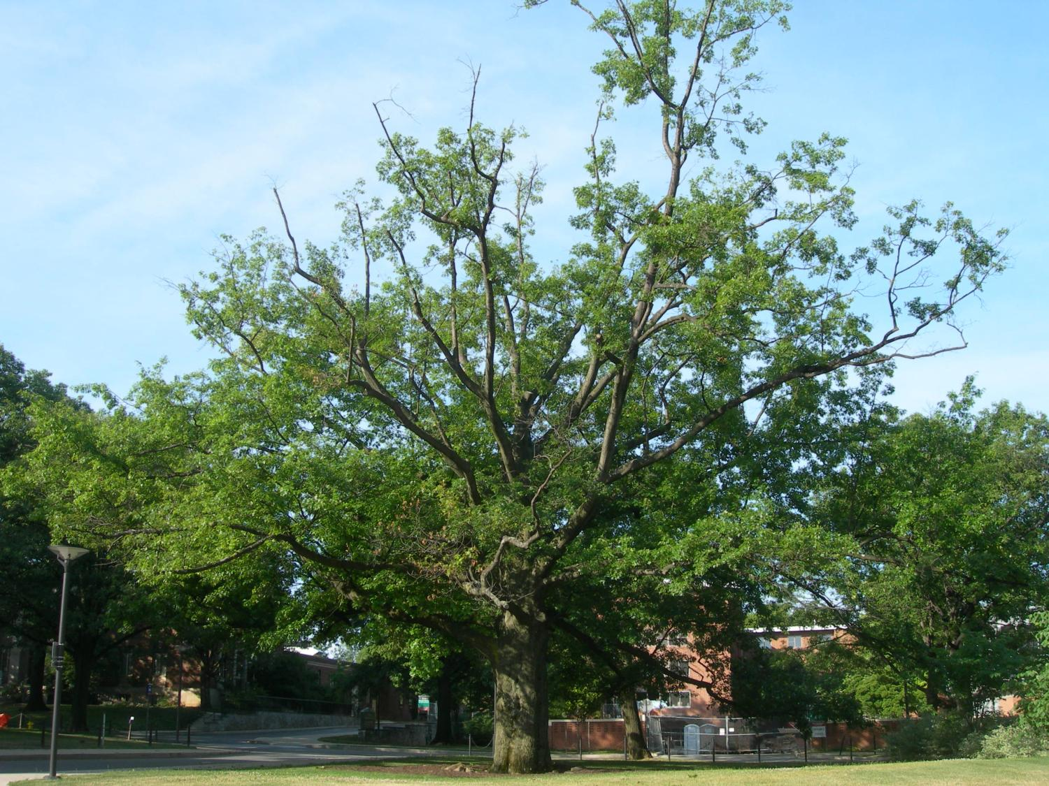
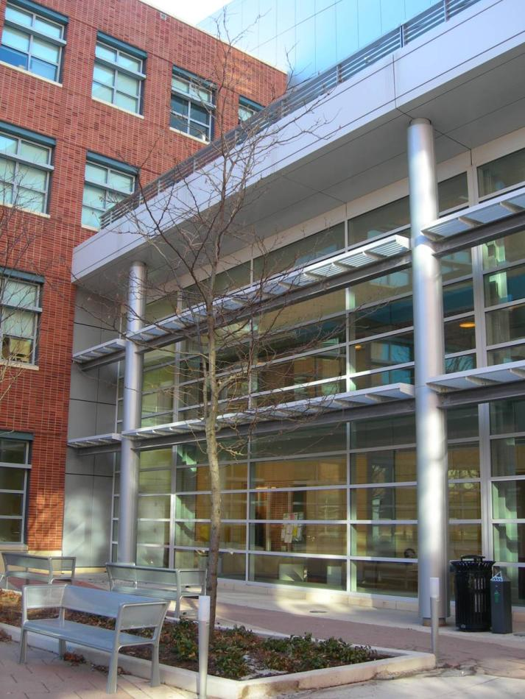
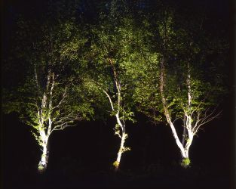
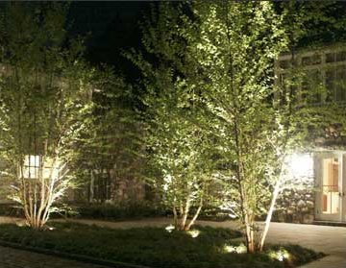
ARCHITECTUREBREADTH

Slide 10
ARCHITECTUREBREADTH

Slide 11
LIGHTING DEPTH
TERRACE
OVERVIEW
Serves as main entrance from campus, a gathering space, café outdoor seating
Trapezoidal, bi-level (ground and third floors), ~14,260 SF
Brick, limestone, aluminum and glass curtain walls
Benches, café seating furniture, planting beds, bronze sculpture
DESIGN GOALS
Link to architecture and rest of campus
Highlight circulation paths and entrance
1 fc average (0.1 fc minimum) along circulation paths
LIGHTINGDEPTH >> TERRACE

Slide 12
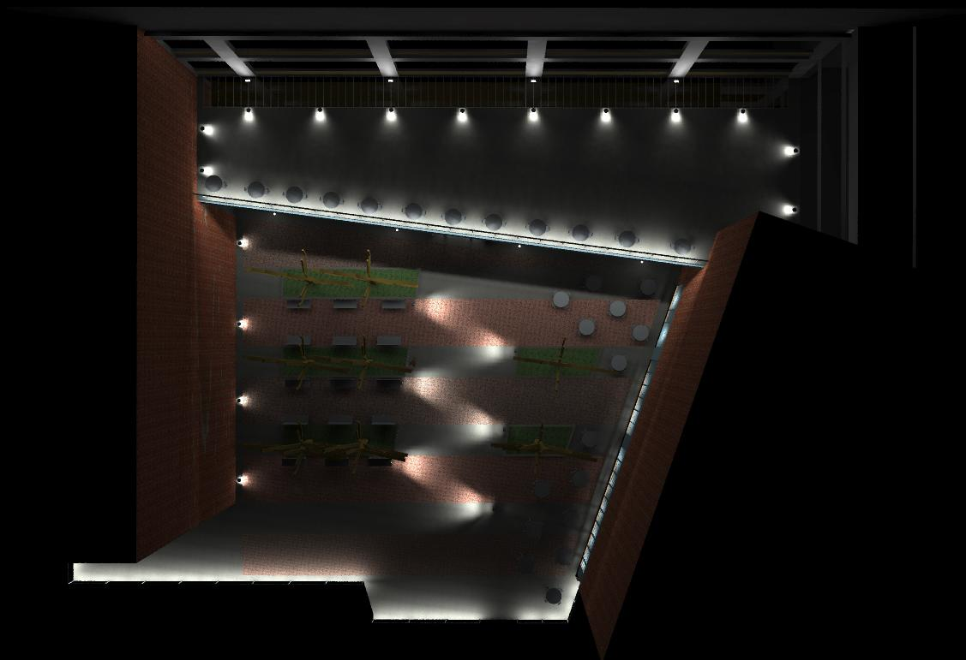

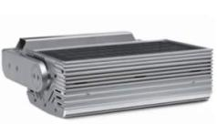

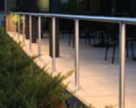
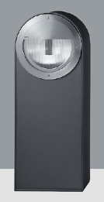
LIGHTINGDEPTH >> TERRACE
L20
L24
L23
L21
L22

Slide 13
ASHRAE 90.1-2004 Power Density Requirements
Table 9.4.5: Building Grounds: Walkways 10 ft wide or greater/Plaza areas
Building Grounds = 0.20 W/SF
Table 9.4.5: Lighting Power Densities for Building Exteriors
Canopies = 1.25 W/SF
Building Façades = 5.00 W/LF
Total Power Allowed per Design Space:
Building Grounds: 0.20 W/SF x 14,260 SF = 2,852 W
Canopies: 1.25 W/SF x 690 SF = 862.5 W
Building Façades: 5.00 W/LF x 380 LF = 1,900 W
LIGHTINGDEPTH>> TERRACE

Slide 14
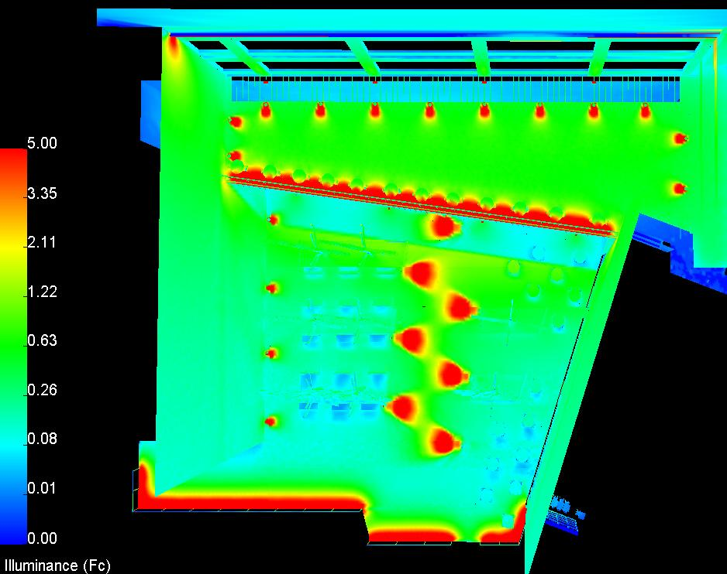
LIGHTINGDEPTH >> TERRACE>> PERFORMANCE
TOTAL POWER:
Type L20: 4 x 99 W = 396 W
Type L21: 4 x 48 W = 192 W
Type L22: 6 x 48 W = 288 W
Type L23: 245.75 ft x 7.6 W/ft = 1,868 W
Type L24: 11 x 48 W = 528 W
Building Grounds: 288 W + 1,868 W + 528 = 2,684 W < 2,852 W
Canopies: 192 W < 863 W
Building Façades: 396 W < 1900 W
OK
OK
OK

Slide 15
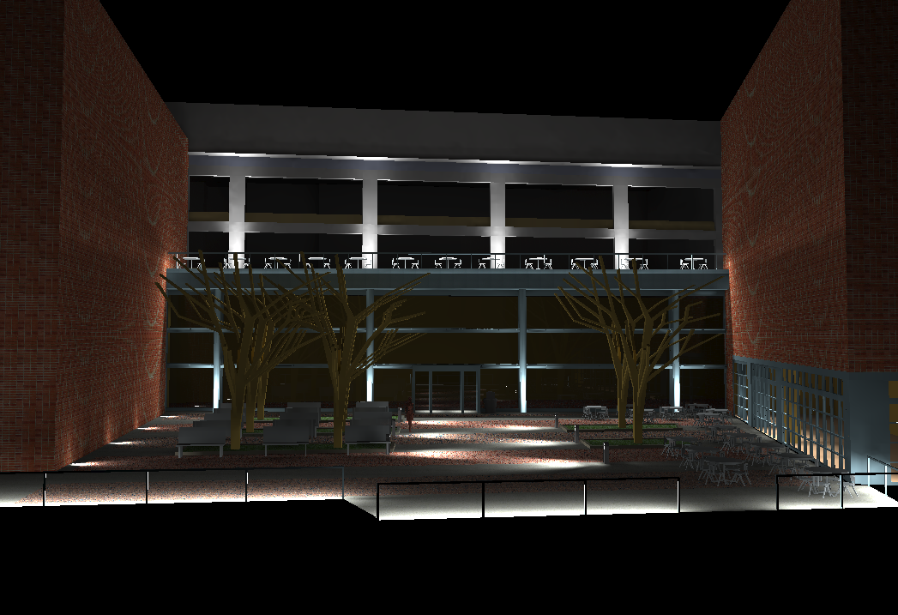
LIGHTINGDEPTH >> TERRACE

Slide 16
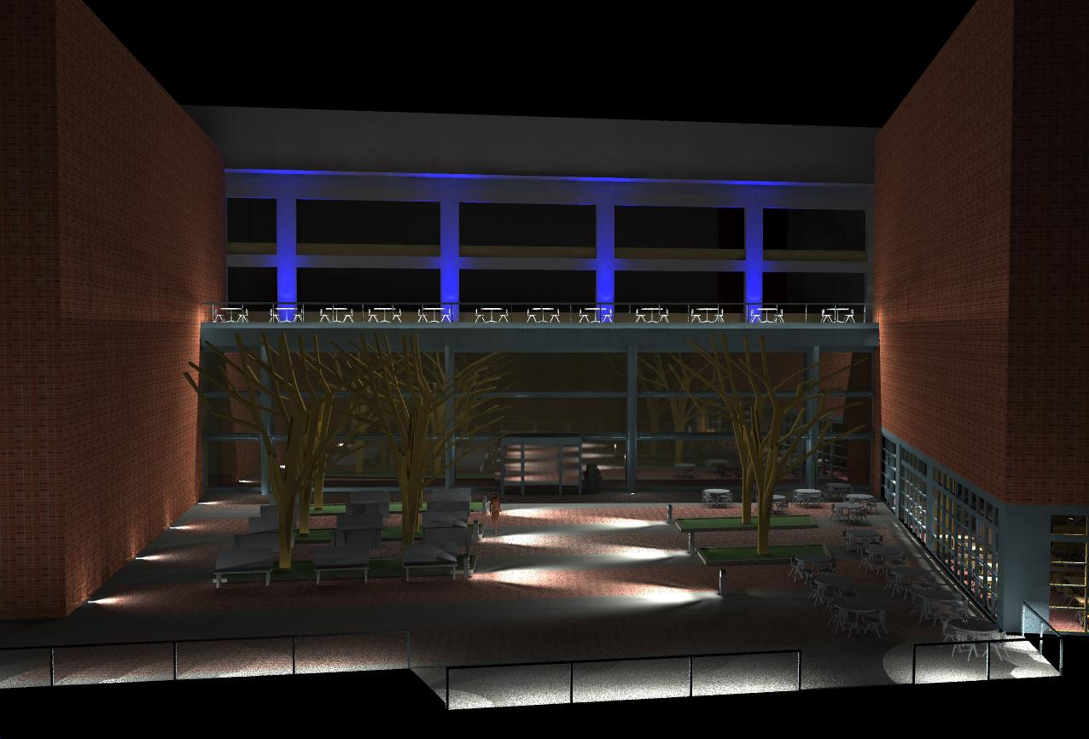
LIGHTINGDEPTH >> TERRACE

Slide 17
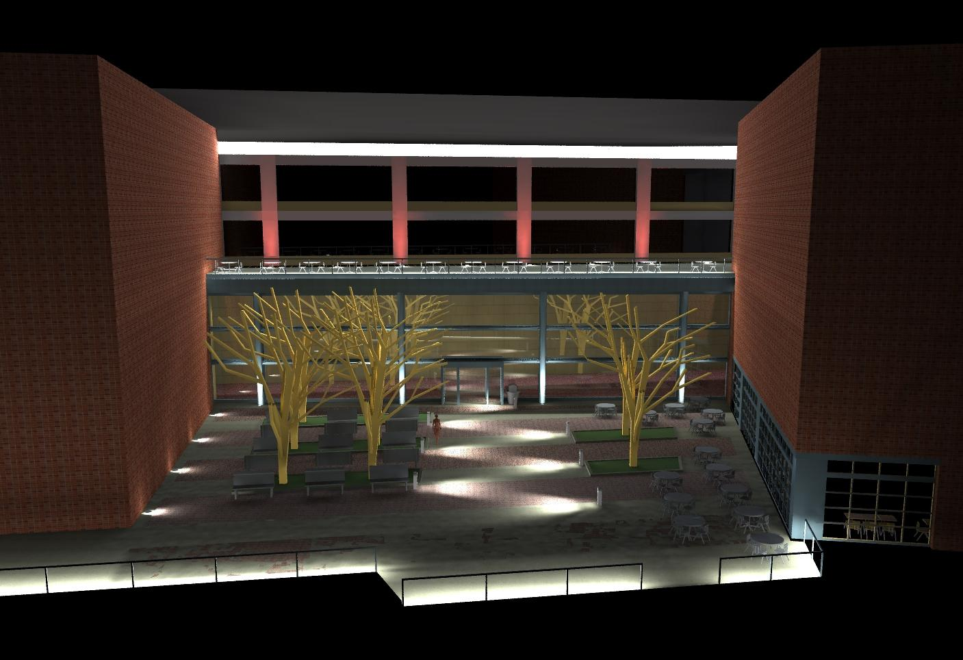
LIGHTINGDEPTH >> TERRACE

Slide 18
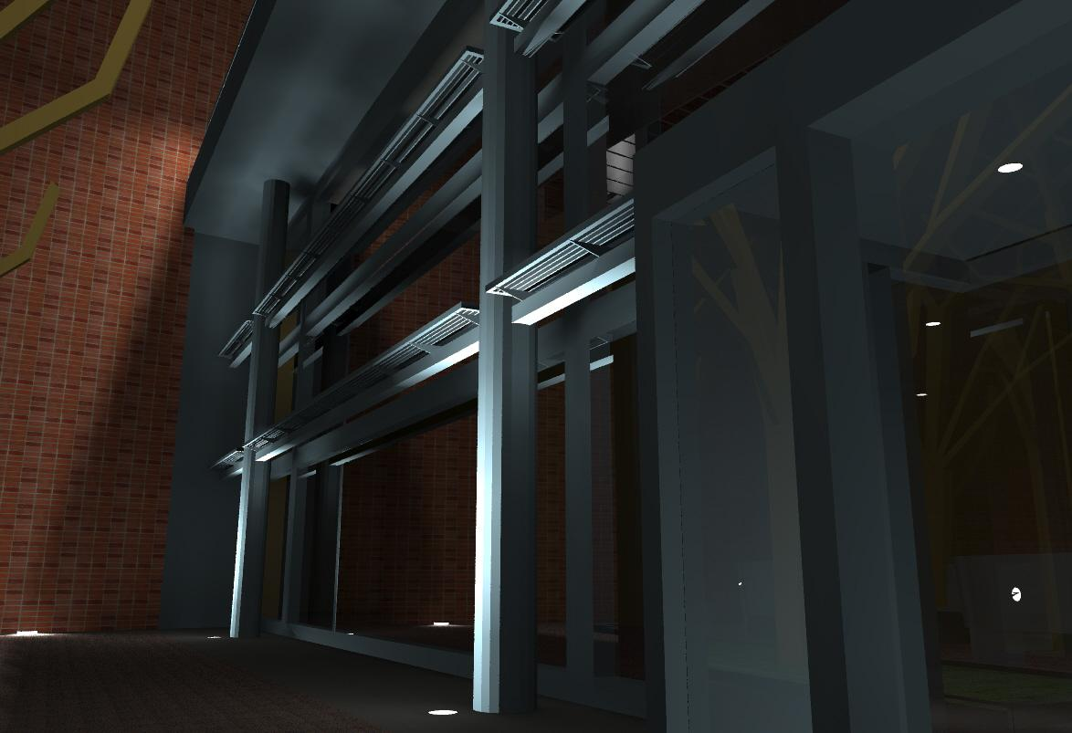
LIGHTINGDEPTH >> TERRACE

Slide 19
LIGHTING DEPTH
THREE ALTERNATE DESIGNS: CLASSROOM
OVERVIEW
44’x30’ (1,330 SF), 60 student capacity
Dark carpeting, ACT ceiling, curved perforated acoustical wood paneling
Tiered, semi-circular seating arrangement with two aisles
DESIGN GOALS
- 60 fc at desk per PSU classroom lighting standard
Conducive to learning
minimize visual clutter to minimize distractions
  flexible controls to adapt to various needs
  THREE ALTERNATE DESIGNS
Option 1: recessed linear striplights in system-organizing ceiling system
Option 2: recessed 2’x2’ lensed direct/indirect troffers
Option 3: direct/indirect linear pendants
LIGHTINGDEPTH>> CLASSROOM

Slide 20
ASHRAE 90.1-2004 Power Density Requirements
Table 9.5.1: Lighting Power Densities Using the Space-by-Space Method
- Classroom/Lecture/Training = 1.40 W/SF
Additional Allowances Per Article 9.6.3(a)
Wall-washers (type L10): 3 fixtures x 114 W/fixture = 342 W
342 W/1,330 SF = 0.26 W/SF
Total LPD: 1.40 W/SF + 0.26 W/SF = 1.66 W/SF
LIGHTINGDEPTH>> CLASSROOM

Slide 21
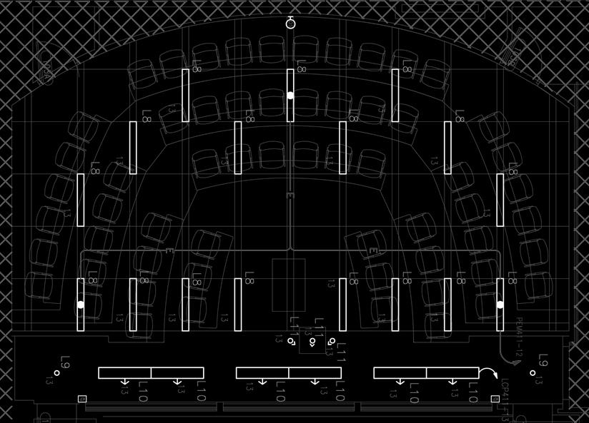
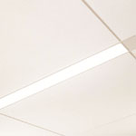
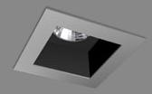
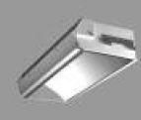
OPTION 1
L8A
L11
L10
LIGHTINGDEPTH>> CLASSROOM>> OPTION 1
L9

Slide 22
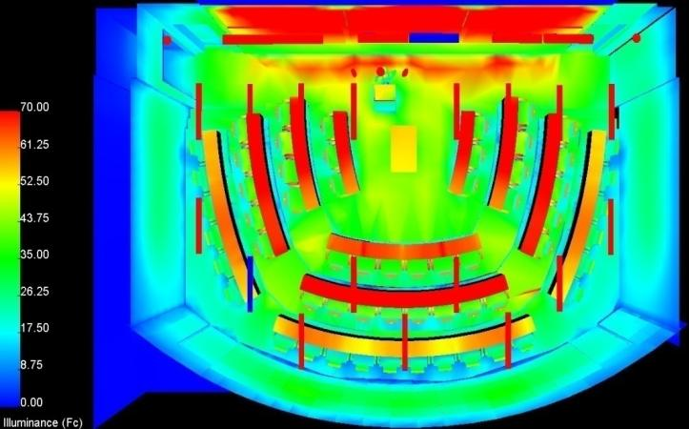
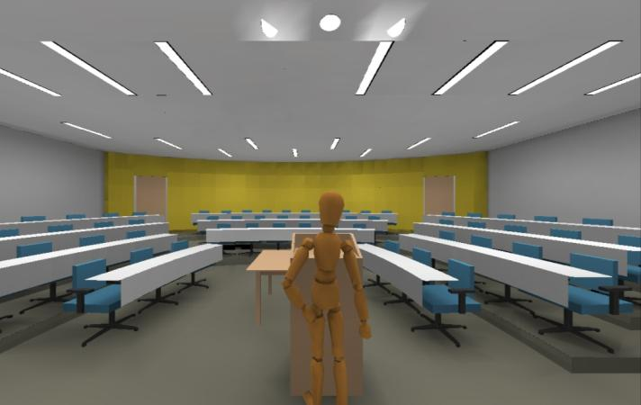
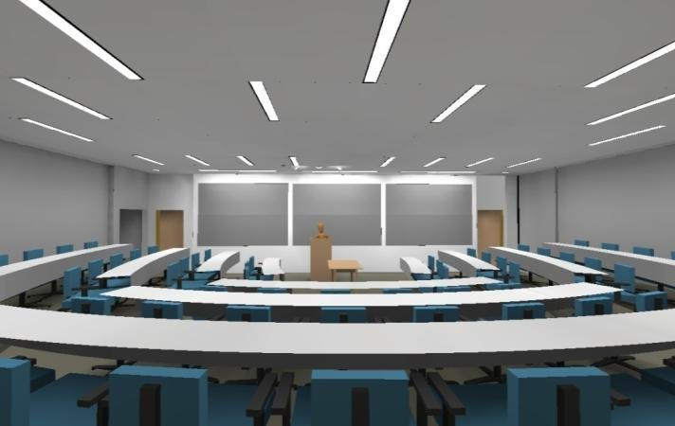
OPTION 1
1 - Recessed Linear Striplights
Type L8A: 6 x 114 W = 1,938 W
Type L9: 2 x 35 W = 70 W
Type L10: 3 x 114 W = 342 W
Type L11: 3 x 35 W = 105 W
Total: 2,455 W → 1.85 W/SF > 1.66 W/SF
TOO HIGH
LIGHTINGDEPTH>> CLASSROOM>> OPTION 1

Slide 23
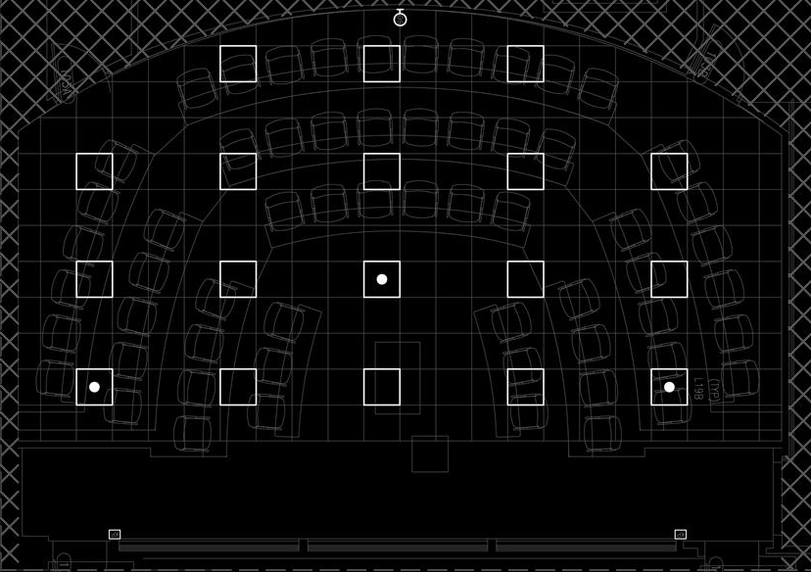

OPTION 2
L8B
L11
L10
L9
LIGHTINGDEPTH>> CLASSROOM>> OPTION 2

Slide 24
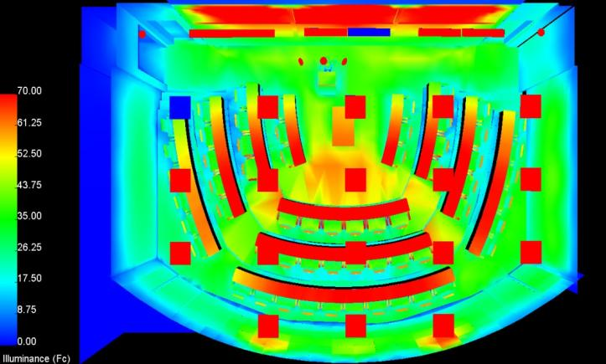
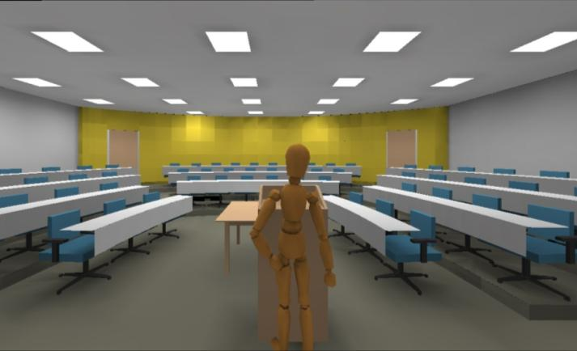
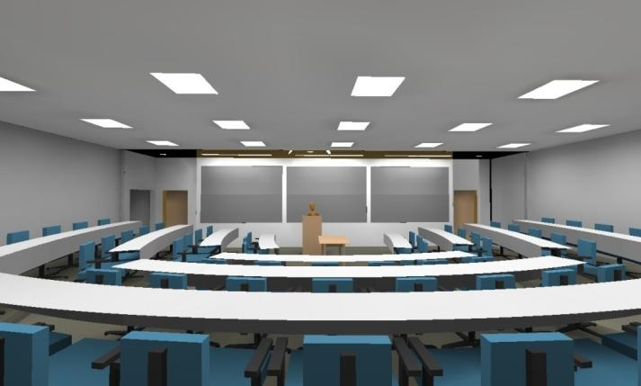
OPTION 2
2 - Recessed Lensed Troffers
Type L8B: 18 x 70 W = 1,260 W
Type L9: 2 x 35 W = 70 W
Type L10: 3 x 114 W = 342 W
Type L11: 3 x 35 W = 105 W
Total: 1,777 W → 1.34 W/SF < 1.66 W/SF
OK
LIGHTINGDEPTH>> CLASSROOM>> OPTION 2

Slide 25
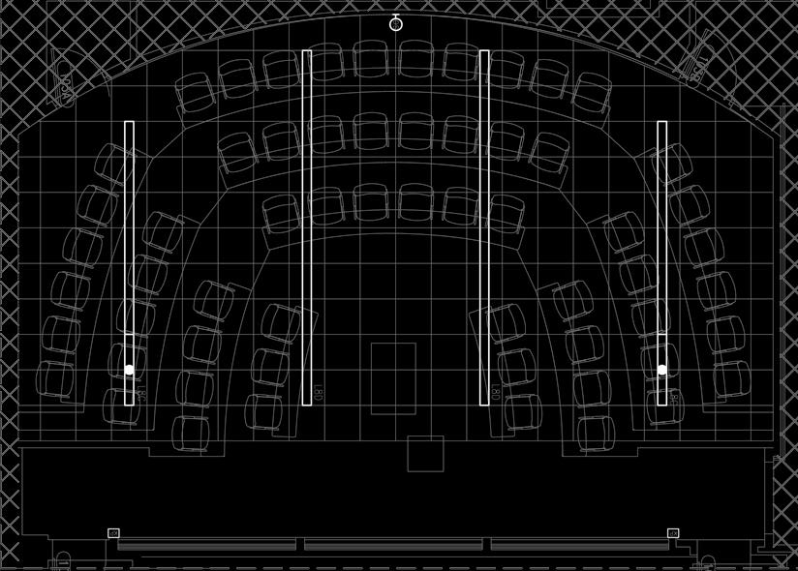
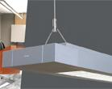
OPTION 3
L8C (16’, 2ckt)
L8D (20’)
L11
L10
L9
LIGHTINGDEPTH>> CLASSROOM>> OPTION 3

Slide 26
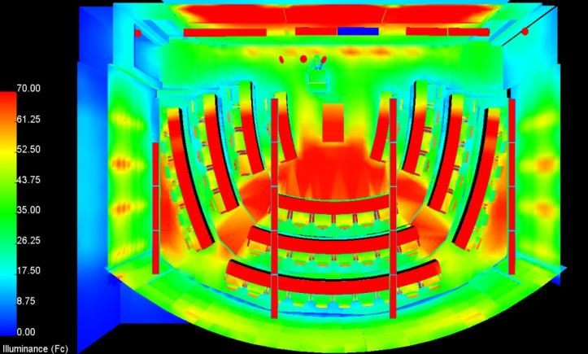
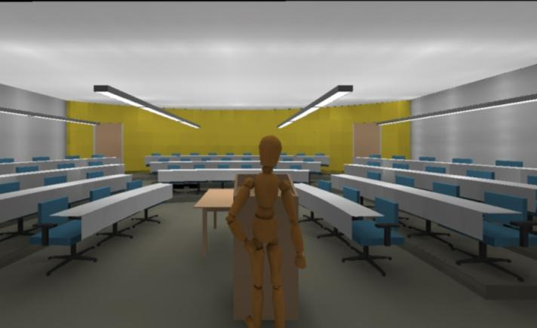
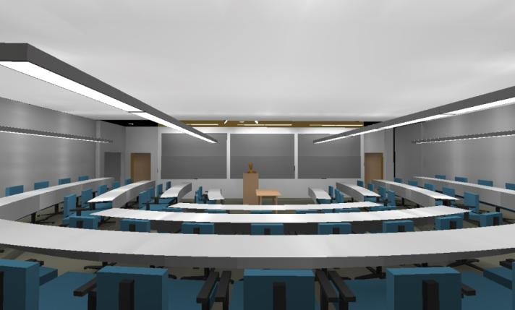
OPTION 3
3 – Direct/Indirect Linear Pendants
Type L8C: 8 x 114 W = 912 W
Type L8D: 10 x 114 W = 1,140 W
Type L9: 2 x 35 W = 70 W
Type L10: 3 x 114 W = 342 W
Type L11: 3 x 35 W = 105 W
Total: 2,569 W → 1.93 W/SF < 1.66 W/SF
TOO HIGH
LIGHTINGDEPTH>> CLASSROOM>> OPTION 3

Slide 27
ELECTRICAL DEPTH
COPPER vs ALUMINUM FEEDER COMPARISON
COMPARISON STUDY BASIS
Feeder samples taken from loads directly serviced by main switchboard ‘MS4L’
  Largest loads → largest feeder sizes → most expensive
  Longest runs (lower level to penthouse level)
Copper’s ampacity equivalent aluminum sizes determined via NEC Table 310-16.
METAL CHARACTERISICS
COPPER
1.6 times the ampacity of aluminum
  smaller sizes → more flexible
  less bulk → easier transport
harder and stronger
  withstands nicks and other mechanical abuse better
corrosion resistant
ALUMINUM
- cheaper than copper
softer; lower modulus of elasticity
higher thermal expansion coefficient
(13.1 micro in/in ºF vs 9.8 micro in/in ºF)
  can loosen joints and connections from frequent expansion/contraction movements
corrodes easily with moisture
ELECTRICALDEPTH>> FEEDERCOMPARISON

Slide 28
COPPER PRICING
 |  |  |  | NO. | CONDUCTORS (PER SET)
 |  |  | LENGTH | OF | PHASE/NEUTRAL |  |  | GROUND
TAG | FROM | TO | [FT] | SETS | No. | SIZE | $/LF | No. | SIZE | $/LF | OCP | TOTAL
18 | MS4L | ATS-EM | 50 | 1 | 4 | 250KCMIL | 28.67 | 1 | 4AWG | 2.12 | 250 | $ 1,539.17
20 | MS4L | DP4L2 | 50 | 1 | 4 | 350KCMIL | 37.33 | 1 | 4AWG | 2.12 | 300 | $ 1,972.50
20 | MS4L | DP4L3 | 45 | 1 | 4 | 350KCMIL | 37.33 | 1 | 4AWG | 2.12 | 300 | $ 1,775.25
24 | MS4L | ATS-LR | 70 | 1 | 4 | 600KCMIL | 47.00 | 1 | 3AWG | 2.29 | 400 | $ 3,450.30
26 | MS4L | DP4P2 | 250 | 2 | 4 | 250KCMIL | 28.67 | 1 | 2AWG | 2.72 | 500 | $15,691.67
28 | MS4L | DP4L1 | 40 | 2 | 4 | 350KCMIL | 37.33 | 1 | 1AWG | 3.90 | 600 | $ 3,298.67
30 | MS4L | DP4P1 | 260 | 2 | 4 | 600KCMIL | 28.67 | 1 | 1/0AWG | 4.08 | 800 | $17,030.00
T7P | MS4L | T7 | 30 | 1 | 3 | 350KCMIL | 28.00 | 1 | 4AWG | 2.12 | 800 | $ 903.50
T7S | T7 | DP2L | 15 | 2 | 4 | 250KCMIL | 28.67 | 1 | 2AWG | 2.72 | 800 | $ 941.50
 |  |  |  |  |  |  |  |  |  | TOTAL |  | $46,602.55
ELECTRICALDEPTH>> FEEDERCOMPARISON

Slide 29
ALUMINUM PRICING
 |  |  |  | NO. | CONDUCTORS (PER SET)
 |  |  | LENGTH | OF | PHASE/NEUTRAL |  |  | GROUND
TAG | FROM | TO | [FT] | SETS | No. | SIZE | $/LF | No. | SIZE | $/LF | OCP | TOTAL
18 | MS4L | ATS-EM | 50 | 1 | 4 | 350KCMIL | 18.53 | 1 | 3AWG | 1.63 | 250 | $ 1,008.17
20 | MS4L | DP4L2 | 50 | 1 | 4 | 500KCMIL | 22.27 | 1 | 3AWG | 1.63 | 300 | $ 1,194.83
20 | MS4L | DP4L3 | 45 | 1 | 4 | 500KCMIL | 22.27 | 1 | 3AWG | 1.63 | 300 | $ 1,075.35
24 | MS4L | ATS-LR | 70 | 2 | 4 | 350KCMIL | 18.53 | 1 | 2AWG | 1.77 | 400 | $ 2,842.00
26 | MS4L | DP4P2 | 250 | 2 | 4 | 350KCMIL | 18.53 | 1 | 1AWG | 1.98 | 500 | $10,258.33
28 | MS4L | DP4L1 | 40 | 3 | 4 | 250KCMIL | 16.80 | 1 | 1/0AWG | 2.42 | 600 | $ 2,306.00
30 | MS4L | DP4P1 | 260 | 3 | 4 | 500KCMIL | 22.27 | 1 | 3/0AWG | 3.05 | 800 | $19,747.00
T7P | MS4L | T7 | 30 | 1 | 3 | 500KCMIL | 16.70 | 1 | 3AWG | 1.63 | 800 | $ 549.90
T7S | T7 | DP2L | 15 | 2 | 4 | 500KCMIL | 22.27 | 1 | 1AWG | 1.98 | 800 | $ 727.50
 |  |  |  |  |  |  |  |  |  | TOTAL |  | $39,709.08
ELECTRICALDEPTH>> FEEDERCOMPARISON

Slide 30
PRICE COMPARISON
Copper: $46,602.55
Aluminum: $39,709.08 → $6,893.47 savings, (14.8%)
Aluminum has the potential to provide a significantly cheaper initial material cost, but may also create greater future maintenance costs in long term projects due to its shorter lifespan.
BOTTOM LINE
Use of copper feeders is recommended for the Smeal Business Building.
ELECTRICALDEPTH>> FEEDERCOMPARISON

Slide 31
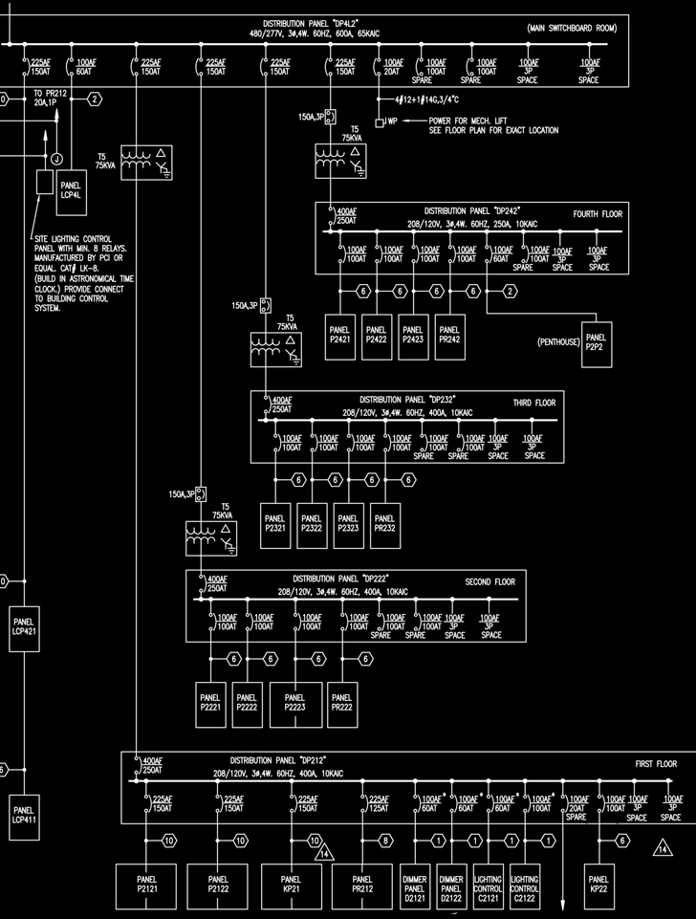
ELECTRICAL DEPTH
DISTRIBUTION PANEL REDESIGN
DESIGN BASIS & ASSUMPTIONS
Panel ‘LCP421’ replaced with ‘LCP411’
208/120V distribution panels fed through 75 kVA transformers
  transformer rating loaded at 80%
  power factor=0.8
Associated feeder used to assume a load for the mechanical lift
Spare circuits loaded at 65% capacity
  power factor=1
  demand factor=1
ELECTRICALDEPTH>> DISTRIBUTION PANEL REDESIGN

Slide 32
LIGHTING AND APPLIANCE PANELBOARD SIZING WORKSHEET
Panel Tag--------------------------> |  |  |  |  | DP4L2 | Panel Location: |  |  | Rm #P103
Nominal Phase to Neutral Voltage-------> |  |  |  |  | 277 | Phase: |  |  | 3
Nominal Phase to Phase Voltage--------> |  |  |  |  | 480 | Wires: |  |  | 4
Pos | Ph. | Load Type | Cat. | Location | Load | Units | I. PF | Watts | VA | Remarks
1 | A | Ltg Panel | 3 | 1st fl | 21600 | VA | 0.95 | 20520 | 21600 | LCP411 (A)
2 | A | Ltg Panel | 3 | lower level | 8500 | VA | 0.95 | 8075 | 8500 | LCP4L (A)
3 | B | - | 3 | - | 18500 | VA | 0.95 | 17575 | 18500 | LCP411 (B)
4 | B | - | 3 | - | 5800 | VA | 0.95 | 5510 | 5800 | LCP4L (B)
5 | C | - | 3 | - | 22000 | VA | 0.95 | 20900 | 22000 | LCP411 (C)
6 | C | - | 3 | - | 2800 | VA | 0.95 | 2660 | 2800 | LCP4L (C)
7 | A | 75 kVA xfmr | 1 | 1st fl | 20000 | VA | 0.80 | 16000 | 20000 | DP212 (A)
8 | A | 75 kVA xfmr | 1 | 2nd fl | 20000 | VA | 0.80 | 16000 | 20000 | DP222 (A)
9 | B | - | 1 | - | 20000 | VA | 0.80 | 16000 | 20000 | DP212 (B)
10 | B | - | 1 | - | 20000 | VA | 0.80 | 16000 | 20000 | DP222 (B)
11 | C | - | 1 | - | 20000 | VA | 0.80 | 16000 | 20000 | DP212 (C)
12 | C | - | 1 | - | 20000 | VA | 0.80 | 16000 | 20000 | DP222 (C)
13 | A | 75 kVA xfmr | 1 | 3rd fl | 20000 | VA | 0.80 | 16000 | 20000 | DP232 (A)
14 | A | 75 kVA xfmr | 1 | 4th fl | 20000 | VA | 0.80 | 16000 | 20000 | DP242 (A)
15 | B | - | 1 | - | 20000 | VA | 0.80 | 16000 | 20000 | DP232 (B)
16 | B | - | 1 | - | 20000 | VA | 0.80 | 16000 | 20000 | DP242 (B)
17 | C | - | 1 | - | 20000 | VA | 0.80 | 16000 | 20000 | DP232 (C)
18 | C | - | 1 | - | 20000 | VA | 0.80 | 16000 | 20000 | DP242 (C)
19 | A | Mech'l Lift | 6 | - | 1477.333 | VA | 0.80 | 1182 | 1477
20 | A | SPARE | 8 | - | 18005 | w | 1.00 | 18005 | 18005 | Updated
21 | B | - | 6 | - | 1477.333 | VA | 0.80 | 1182 | 1477
22 | B | SPARE | 8 | - | 18005 | w | 1.00 | 18005 | 18005 | Updated
23 | C | - | 6 | - | 1477.333 | VA | 0.80 | 1182 | 1477
24 | C | SPARE | 8 | - | 18005 | w | 1.00 | 18005 | 18005 | Updated
25 | A | SPACE |  |  |  | w |  | 0 | 0
26 | A | SPACE |  |  |  | w |  | 0 | 0
27 | B | - |  |  |  | w |  | 0 | 0
28 | B | - |  |  |  | w |  | 0 | 0
29 | C | - |  |  |  | w |  | 0 | 0
30 | C | - |  |  |  | w |  | 0 | 0
PANEL TOTAL |  |  |  |  |  |  | 324.8 | 377.6 | Amps= | 454.4
PHASE LOADING |  |  |  |  |  |  | kW | kVA | % | Amps
PHASE TOTAL |  | A |  |  |  |  | 111.8 | 129.6 | 34% | 467.8
PHASE TOTAL |  | B |  |  |  |  | 106.3 | 123.8 | 33% | 446.9
PHASE TOTAL |  | C |  |  |  |  | 106.7 | 124.3 | 33% | 448.7
LOAD CATAGORIES |  |  | Connected |  |  | Demand |  |  |  | Ver. 1.01
 |  |  | kW | kVA | DF | kW | kVA | PF
1 | receptacles |  | 192.0 | 240.0 | 0.50 | 96.0 | 120.0 | 0.80
2 | computers |  | 0.0 | 0.0 | 0.00 | 0.0 | 0.0
3 | fluorescent lighting |  | 75.2 | 79.2 | 1.00 | 75.2 | 79.2 | 0.95
4 | HID lighting |  | 0.0 | 0.0 | 0.00 | 0.0 | 0.0
5 | incandescent lighting |  | 0.0 | 0.0 | 0.00 | 0.0 | 0.0
6 | HVAC fans |  | 3.5 | 4.4 | 0.50 | 1.8 | 2.2 | 0.80
7 | heating |  | 0.0 | 0.0 | 0.00 | 0.0 | 0.0
8 | Spare |  | 54.0 | 54.0 | 1.00 | 54.0 | 54.0 | 1.00
Total Demand Loads |  |  |  |  |  | 227.0 | 255.4
Spare Capacity |  |  | 20% |  |  | 45.4 | 51.1
Total Design Loads |  |  |  |  |  | 272.4 | 306.5 | 0.89 | Amps= | 368.9
400A / MLO
400A breaker @‘MS4L’
4 -#600KCMIL+1#3G in 4”C
ELECTRICALDEPTH>> DISTRIBUTION PANEL REDESIGN

Slide 33
P A N E L B O A R D S C H E D U L E
VOLTAGE: |  | 480Y/277V,3PH,4W |  | PANEL TAG: |  |  | DP4L2 |  |  |  | MIN. C/B AIC: | 65K
SIZE/TYPE BUS: |  | 400A |  | PANEL LOCATION: |  |  | Rm #P103 |  |  |  | OPTIONS:
SIZE/TYPE MAIN: |  | MLO |  | PANEL MOUNTING: |  |  | SURFACE
DESCRIPTION | LOCATION |  | LOAD (WATTS) | C/B SIZE | POS. NO. | A | B | C | POS. NO. | C/B SIZE | LOAD (WATTS) | LOCATION | DESCRIPTION
Ltg Panel | 1st fl |  | 20520 | 100A/3P | 1 | * |  |  | 2 | 60A/3P | 8075 | lower level | Ltg Panel
- | - |  | 17575 |  | 3 |  | * |  | 4 |  | 5510 | - | -
- | - |  | 20900 |  | 5 |  |  | * | 6 |  | 2660 | - | -
75 kVA xfmr | 1st fl |  | 16000 | 150A/3P | 7 | * |  |  | 8 | 150A/3P | 16000 | 2nd fl | 75 kVA xfmr
- | - |  | 16000 |  | 9 |  | * |  | 10 |  | 16000 | - | -
- | - |  | 16000 |  | 11 |  |  | * | 12 |  | 16000 | - | -
75 kVA xfmr | 3rd fl |  | 16000 | 150A/3P | 13 | * |  |  | 14 | 150A/3P | 20000 | 4th fl | 75 kVA xfmr
- | - |  | 16000 |  | 15 |  | * |  | 16 |  | 20000 | - | -
- | - |  | 16000 |  | 17 |  |  | * | 18 |  | 20000 | - | -
Mech'l Lift | - |  | 1182 | 20A/3P | 19 | * |  |  | 20 | 100A/1P | 18005 |  | SPARE
- | - |  | 1182 |  | 21 |  | * |  | 22 | 100A/1P | 18005 |  | SPARE
- | - |  | 1182 |  | 23 |  |  | * | 24 | 100A/1P | 18005 |  | SPARE
SPACE |  |  |  | 3P | 25 | * |  |  | 26 | 3P |  |  | SPACE
- |  |  |  |  | 27 |  | * |  | 28 |  |  |  | -
- |  |  |  |  | 29 |  |  | * | 30 |  |  |  | -
CONNECTED LOAD (KW) - A |  |  | 111.78 |  |  |  |  |  |  |  | TOTAL DESIGN LOAD (KW) |  | 272.43
CONNECTED LOAD (KW) - B |  |  | 106.27 |  |  |  |  |  |  |  | POWER FACTOR |  | 0.89
CONNECTED LOAD (KW) - C |  |  | 106.75 |  |  |  |  |  |  |  | TOTAL DESIGN LOAD (AMPS) |  | 369
ELECTRICALDEPTH>> DISTRIBUTION PANEL REDESIGN

Slide 34
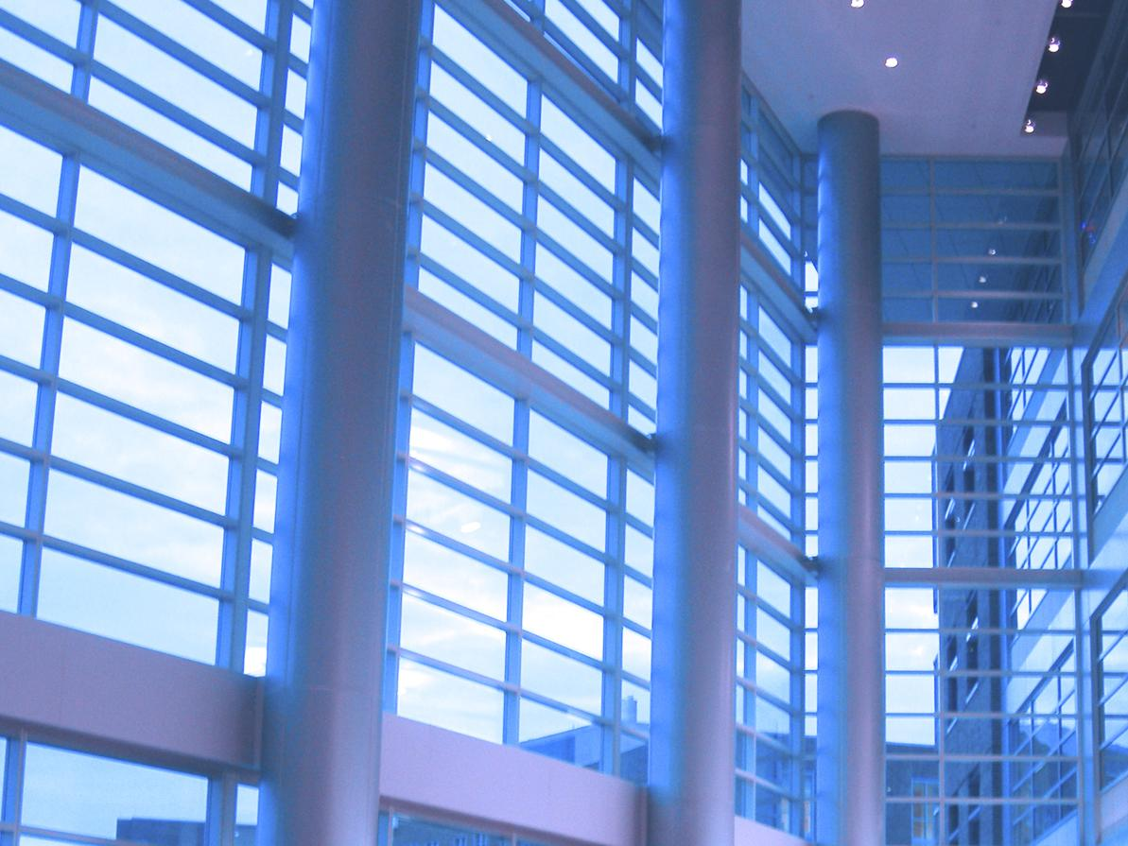
Thank You
BR+A Consulting Engineers
BLT Architects
Robert A.M. Stern Architects
Penn State OPP
Penn State A E Faculty
SmithGroup, Inc.
Friends & Family
Solar Decathlon 2007 Team
Caffeine
Bikram Yoga

